Slide 1
Bundoora Family Clinic
Digital Prescription & Medication Tracking Management System (DPMTMS)
FINAL SRS
System Analysis • Design • Security • Testing
CPRO306 Capstone Project — Final SRS Presentation
Group Members
Kunjan Tamang
Darpan Kafle
Puja Gurung
Yam Bahadur Mohatra
Utsav Paudel
Presenter: All group members
1

Slide 2
Project Scope, Limitations & Deliverables
REQUIREMENTS
The final SRS defines what is included and what remains outside scope.
In scope
Out of scope
Key limitations
User/role management • digital prescriptions • dispensing • inventory • reminders/alerts • reports • security/audit.
Payment gateways • physical lab/medical-device integration • native desktop app • full EHR • insurance claims • hospital admission • laboratory result management.
Network dependency • third-party email/SMS dependency • concurrent database contention • human input errors • performance variability • security cannot be guaranteed absolutely.
Deliverables
SRS requirements, database design, ERD, architecture, UI/UX wireframes, prototype, test plan/cases/data/results and deployment lifecycle artifacts.
Presenter: Kunjan Tamang
6

Slide 3
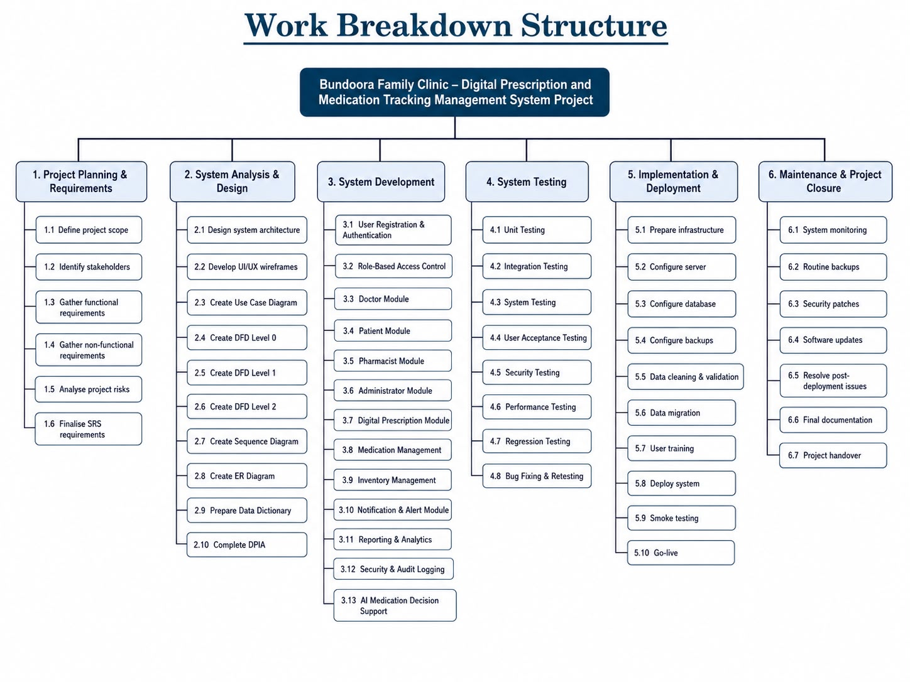
Work Breakdown Structure (WBS)
Project activities are decomposed into six major work packages, from planning and requirements through maintenance and closure.
Presenter: Kunjan Tamang

Slide 4
Functional Requirements — Table 1
FR01–09 | Exact table structure from the Final SRS Report
FR No. | Functional Requirement | CRUD | Module | Comment
FR01 | Register User | C | User Management | Creates a new user account.
FR02 | Validate Registration | C | User Management | Validates all registration fields before submission.
FR03 | Verify User Account | U | User Management | Verifies accounts using email or OTP.
FR04 | Login User | R | User Management | Authenticates registered users.
FR05 | Reset Password | U | User Management | Allows users to securely reset passwords.
FR06 | Manage User Accounts | D | User Management | Admin activates, deactivates, or deletes accounts.
FR07 | Assign User Roles | C | Role-Based Access Control | Assigns Doctor, Patient, Pharmacist, and Admin roles.
FR08 | Restrict Module Access | R | Role-Based Access Control | Provides access according to user roles.
FR09 | Dashboard Redirection | R | Role-Based Access Control | Redirects users to their relevant dashboard.
Presenter: Kunjan Tamang • Source: Final SRS Report

Slide 5
Functional Requirements — Table 2
FR10–18 | Exact table structure from the Final SRS Report
FR No. | Functional Requirement | CRUD | Module | Comment
FR10 | Create Digital Prescription | C | Doctor Module | Doctor creates a prescription for a patient.
FR11 | Select Patient | R | Doctor Module | Retrieves patient details from the database.
FR12 | Add Medicine Details | C | Doctor Module | Adds medicine name, dosage, frequency, and duration.
FR13 | Add Diagnosis and Clinical Notes | C | Doctor Module | Records diagnosis and medical notes.
FR14 | Generate Prescription ID | C | Prescription Management | Creates a unique prescription identifier.
FR15 | Manage Prescription | U | Doctor Module | Allows doctors to view, edit, or cancel prescriptions.
FR16 | Digitally Sign Prescription | U | Doctor Module | Confirms prescription using digital signature.
FR17 | Send Prescription Notification | C | Notification Module | Notifies patient and pharmacist about new prescriptions.
FR18 | View Prescriptions | R | Patient Module | Allows patients to view active and past prescriptions.
Presenter: Darpan Kafle • Source: Final SRS Report

Slide 6
Functional Requirements — Table 3
FR19–27 | Exact table structure from the Final SRS Report
FR No. | Functional Requirement | CRUD | Module | Comment
FR19 | Receive Prescription Notifications | R | Patient Module | Sends prescription updates through email or SMS.
FR20 | Medication Reminders | R | Notification Module | Sends medication schedule reminders.
FR21 | Update Medication Status | U | Patient Module | Allows patients to mark doses as Taken or Missed.
FR22 | Request Prescription Renewal | C | Patient Module | Allows patients to request prescription renewal.
FR23 | Update Patient Information | U | Patient Module | Updates patient profile details.
FR24 | View Dispensing Status | R | Patient Module | Displays pharmacy dispensing updates.
FR25 | View Assigned Prescriptions | R | Pharmacist Module | Pharmacists view assigned prescriptions.
FR26 | Verify Prescription Authenticity | R | Pharmacist Module | Validates digital prescription signatures.
FR27 | Update Dispensing Status | U | Pharmacist Module | Updates prescription status as Pending, Ready, or Collected.
Presenter: Puja Gurung • Source: Final SRS Report

Slide 7
Functional Requirements — Table 4
FR28–36 | Exact table structure from the Final SRS Report
FR No. | Functional Requirement | CRUD | Module | Comment
FR28 | Update Medicine Stock | U | Inventory Management | Automatically updates stock after dispensing.
FR29 | Record Medicine Batch Details | C | Pharmacist Module | Stores batch number and expiry information.
FR30 | Generate Dispensing Report | R | Pharmacist Module | Creates daily dispensing reports.
FR31 | Store Medicine Details | C | Inventory Management | Stores medicine information including price and expiry.
FR32 | View Stock Availability | R | Inventory Management | Displays real-time medicine stock levels.
FR33 | Generate Low Stock Alert | R | Inventory Management | Alerts users when stock is below threshold.
FR34 | Generate Inventory Reports | R | Inventory Management | Creates expired and low-stock medicine reports.
FR35 | Send User Notifications | C | Notification Module | Sends email or SMS notifications.
FR36 | Generate Refill Alerts | C | Notification Module | Alerts patients when prescriptions expire.
Presenter: Yam Bahadur Mohatra • Source: Final SRS Report

Slide 8
Functional Requirements — Table 5
FR37–45 | Exact table structure from the Final SRS Report
FR No. | Functional Requirement | CRUD | Module | Comment
FR37 | Send Missed Dose Alerts | C | Notification Module | Alerts doctors about repeated missed doses.
FR38 | Generate System Reports | R | Reporting and Analytics | Generates reports for users, prescriptions, and medicine usage.
FR39 | Display Analytics Charts | R | Reporting and Analytics | Displays prescription and adherence statistics.
FR40 | Export Reports | R | Reporting and Analytics | Allows export in PDF and CSV formats.
FR41 | Encrypt Sensitive Data | U | Security Module | Protects passwords and medical information.
FR42 | Maintain Audit Logs | C | Security Module | Records user activities with timestamps and IP addresses.
FR43 | Automatic Logout | U | Security Module | Logs out inactive users after a defined period.
FR44 | Suggest Medication | R | AI Decision Support | Provides medication suggestions based on diagnosis.
FR45 | Detect Drug Interactions | R | AI Decision Support | Identifies possible drug interactions and allergy conflicts.
Presenter: Utsav Paudel • Source: Final SRS Report

Slide 9
System Design — User Interface Showcase
UI / UX
The report provides a role-based UI journey from landing page through Doctor, Admin, Patient and Pharmacist modules.
Public & Access
Doctor
Administrator
Landing page, services, login, staff role selection, password reset, OTP verification and registration.
Dashboard, patient reports and prescription creation/editing with digital signature.
Dashboard, user management, audit logs, reports, settings, notifications and inventory.
Patient
Pharmacist
Dashboard, prescription details, profile and medication tracking.
Dashboard, assigned prescriptions, verification, dispensing, inventory, reports and profile.
All UI screenshots on the following slides are reproduced from the attached Final SRS report.
13

Slide 10
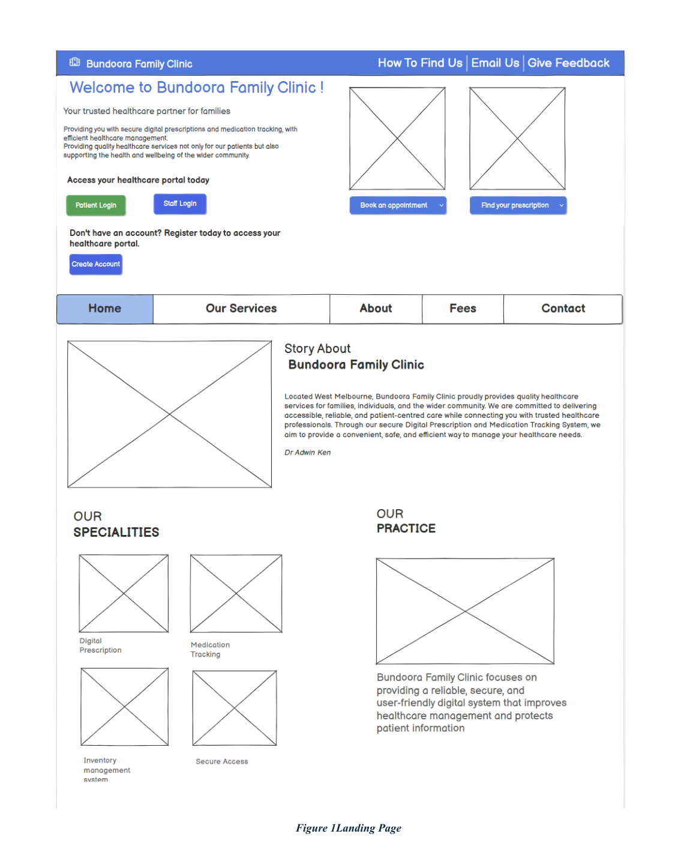
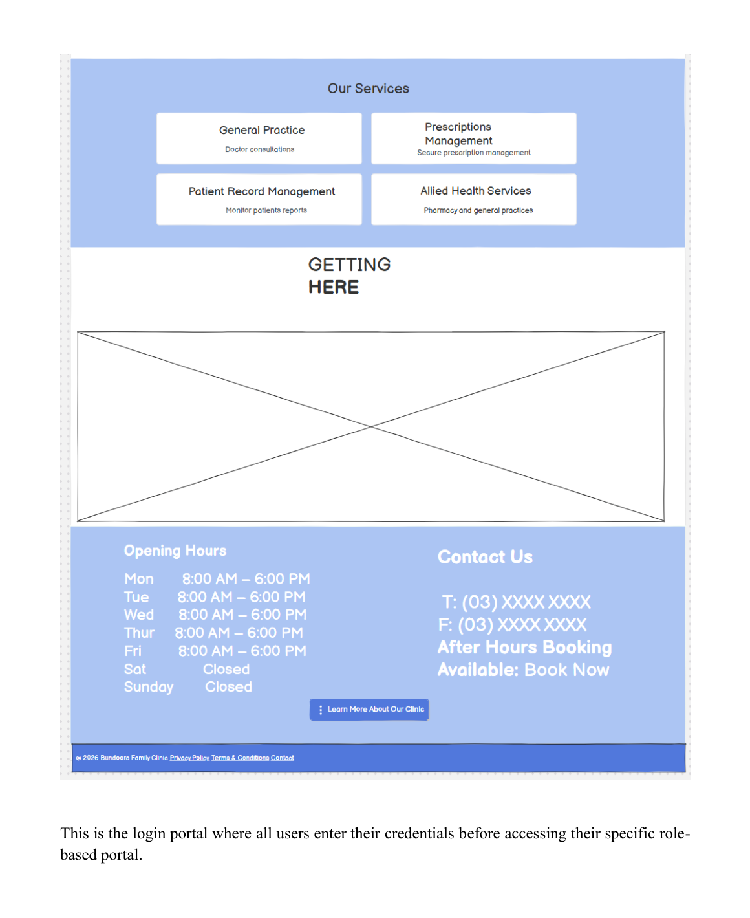
UI Showcase — Landing Page & Services / Clinic Information
UI / ACCESS
Role-based interface screens reproduced from the final SRS report.
Figure/page Landing Page
Figure/page Services / Clinic Information
14

Slide 11
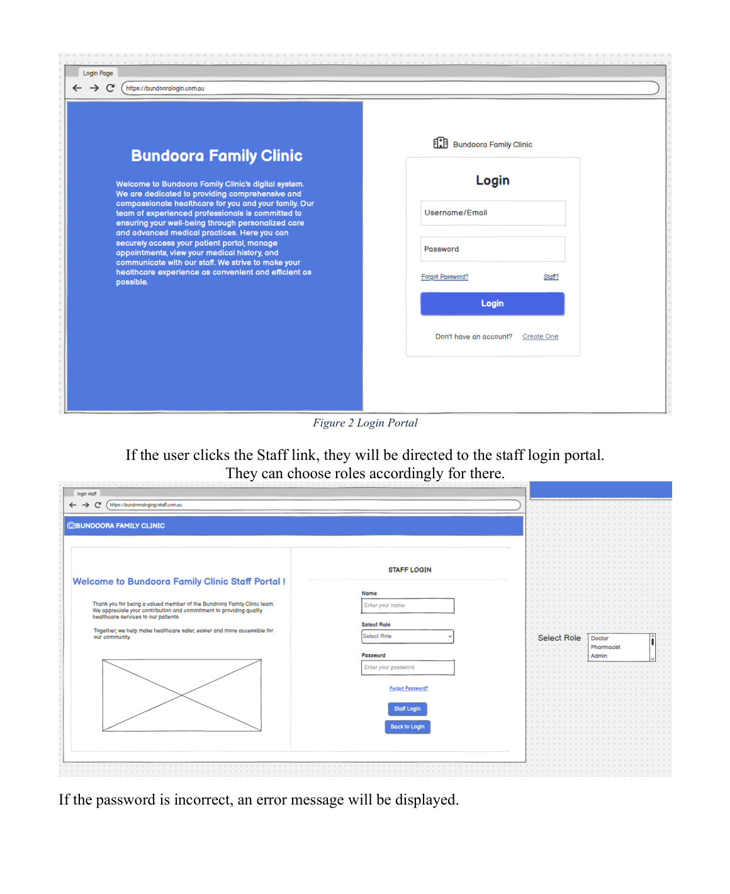
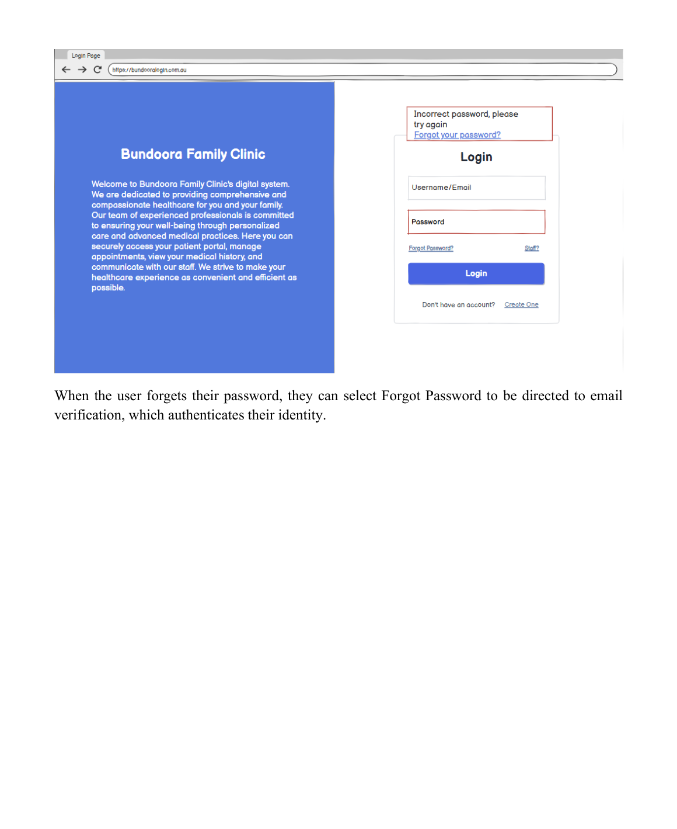
UI Showcase — Login Portal & Staff Login & Login Error & Forgot Password
UI / ACCESS
Role-based interface screens reproduced from the final SRS report.
Figure/page Login Portal & Staff Login
Figure/page Login Error & Forgot Password
15

Slide 12
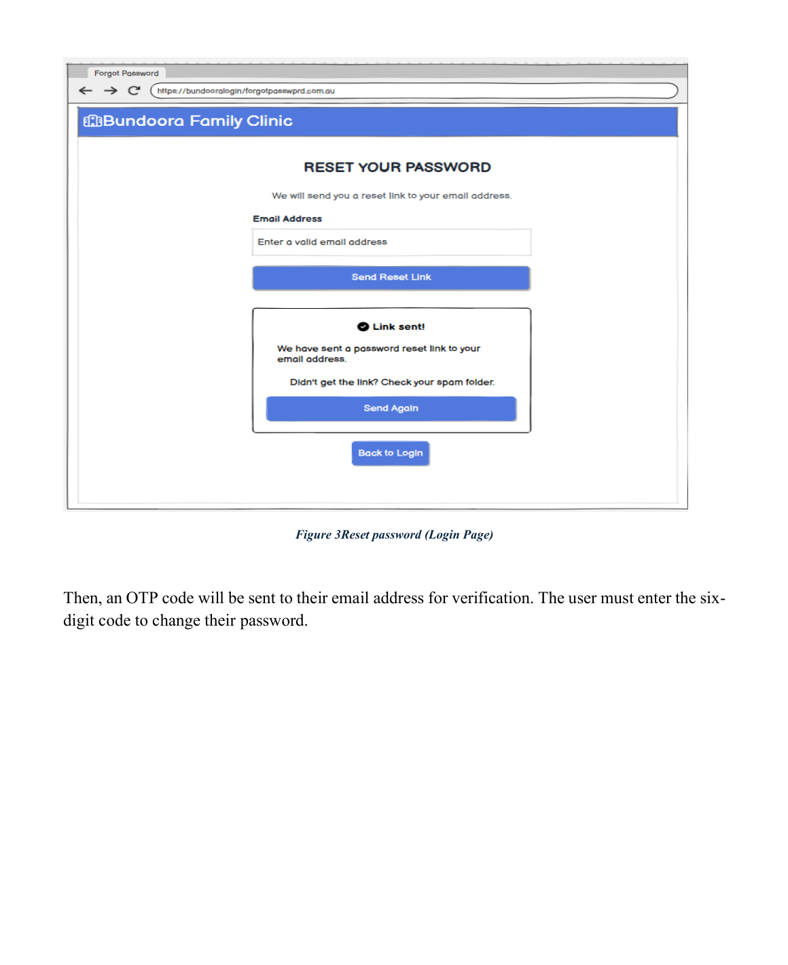
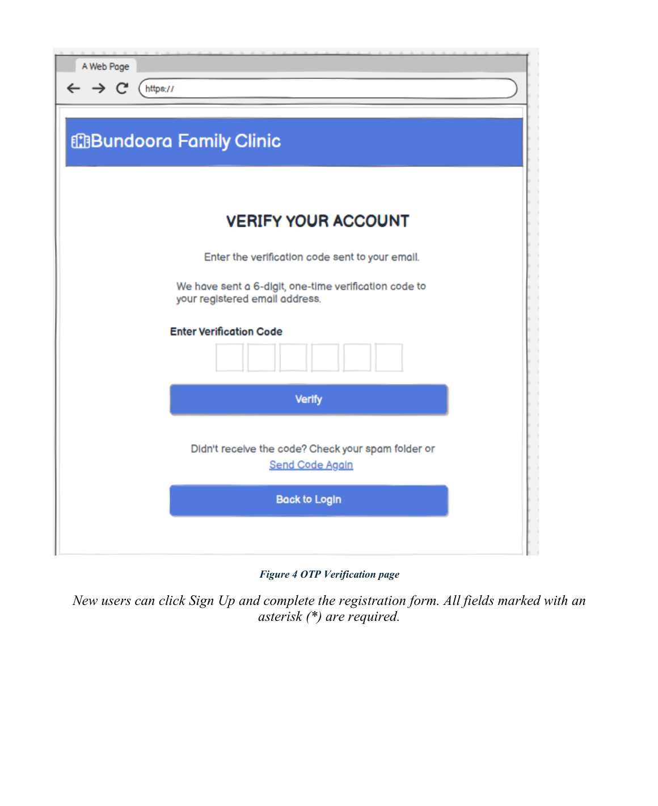
UI Showcase — Reset Password & OTP Verification
UI / ACCESS
Role-based interface screens reproduced from the final SRS report.
Figure/page Reset Password
Figure/page OTP Verification
16

Slide 13
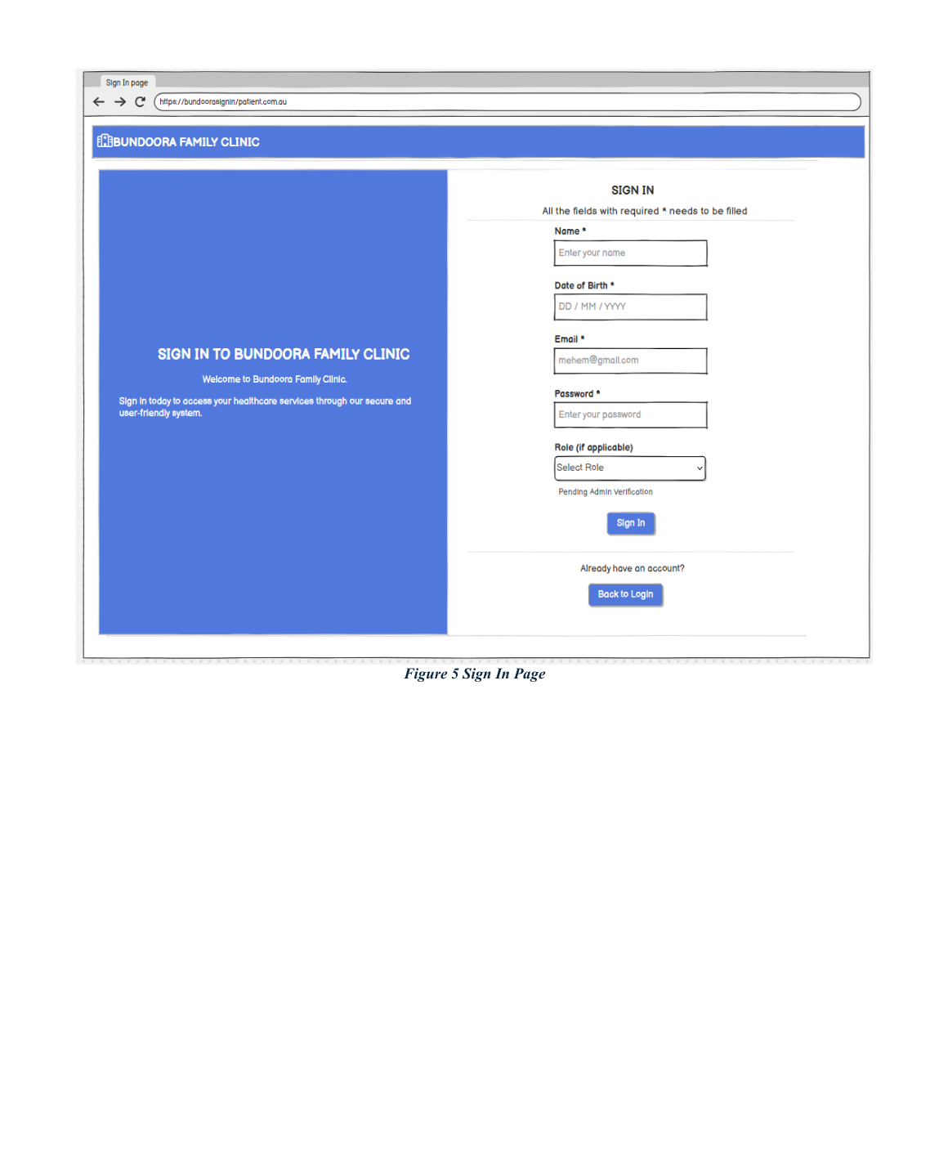
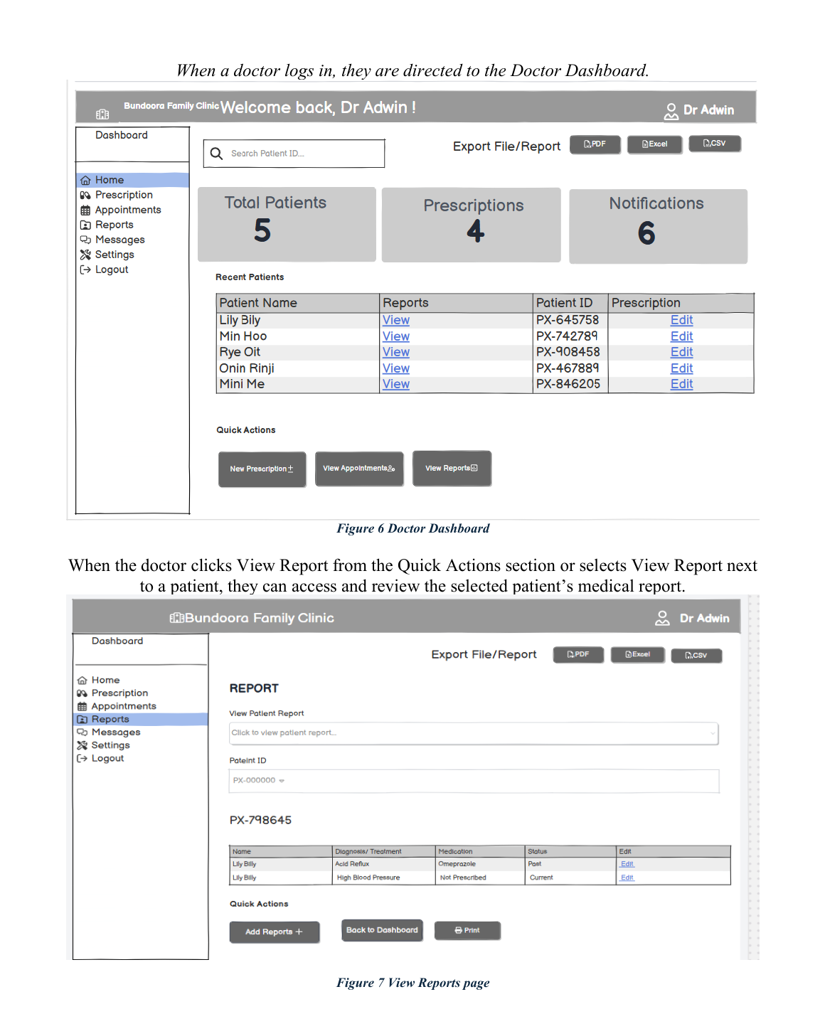
UI Showcase — Sign In / Registration & Doctor Dashboard & Patient Reports
UI / ACCESS
Role-based interface screens reproduced from the final SRS report.
Figure/page Sign In / Registration
Figure/page Doctor Dashboard & Patient Reports
Presenter: Puja
17

Slide 14
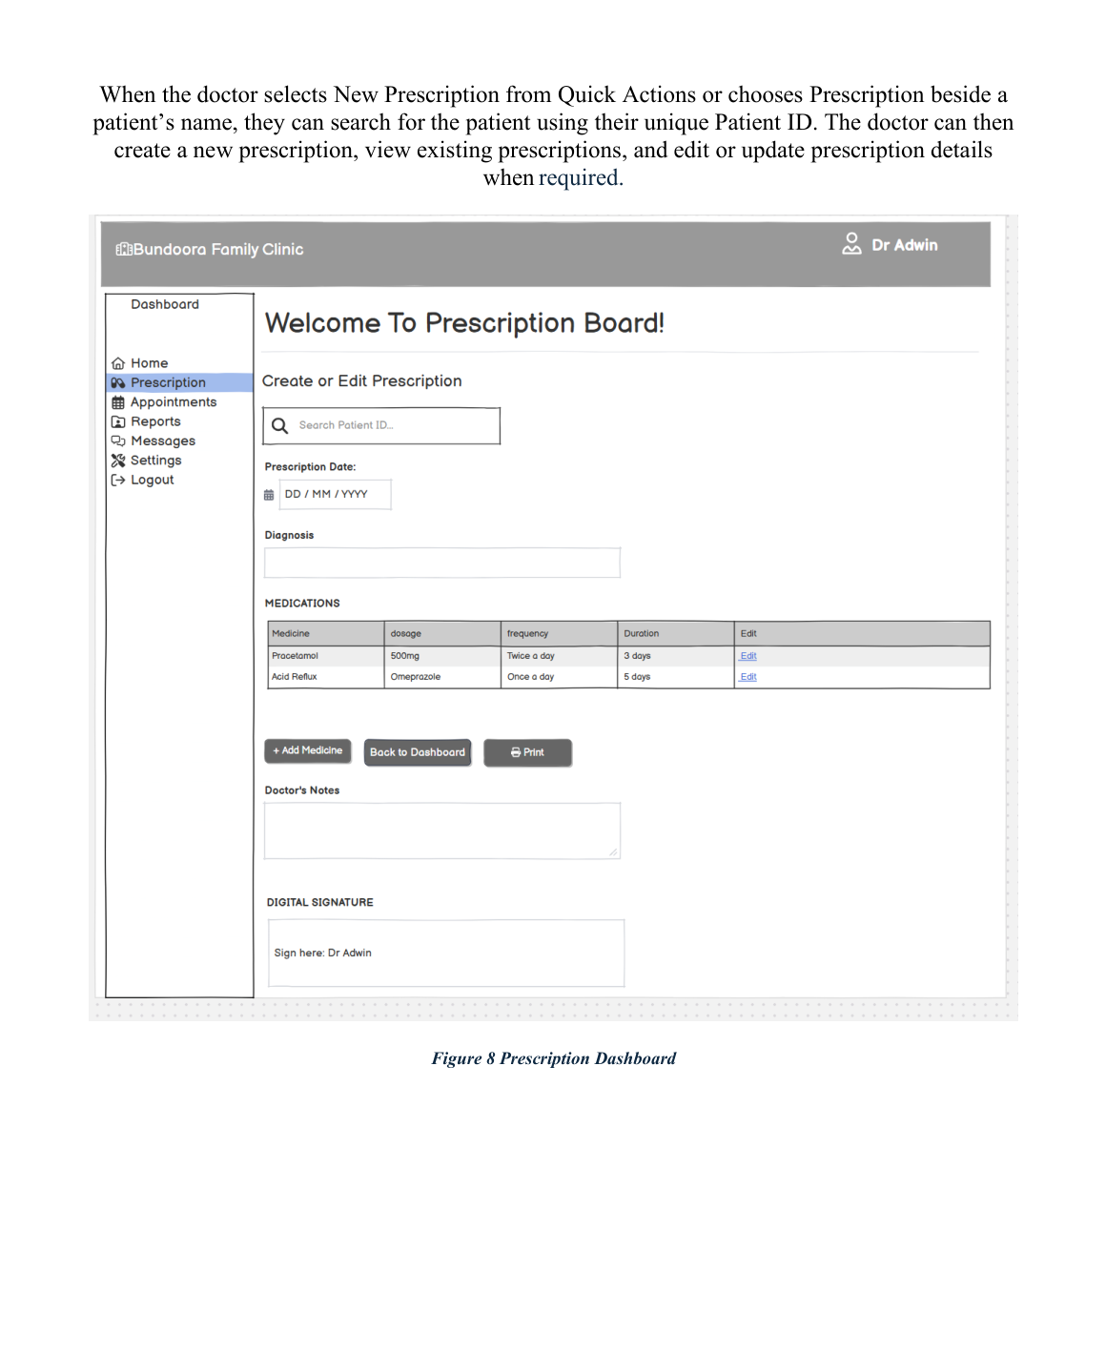
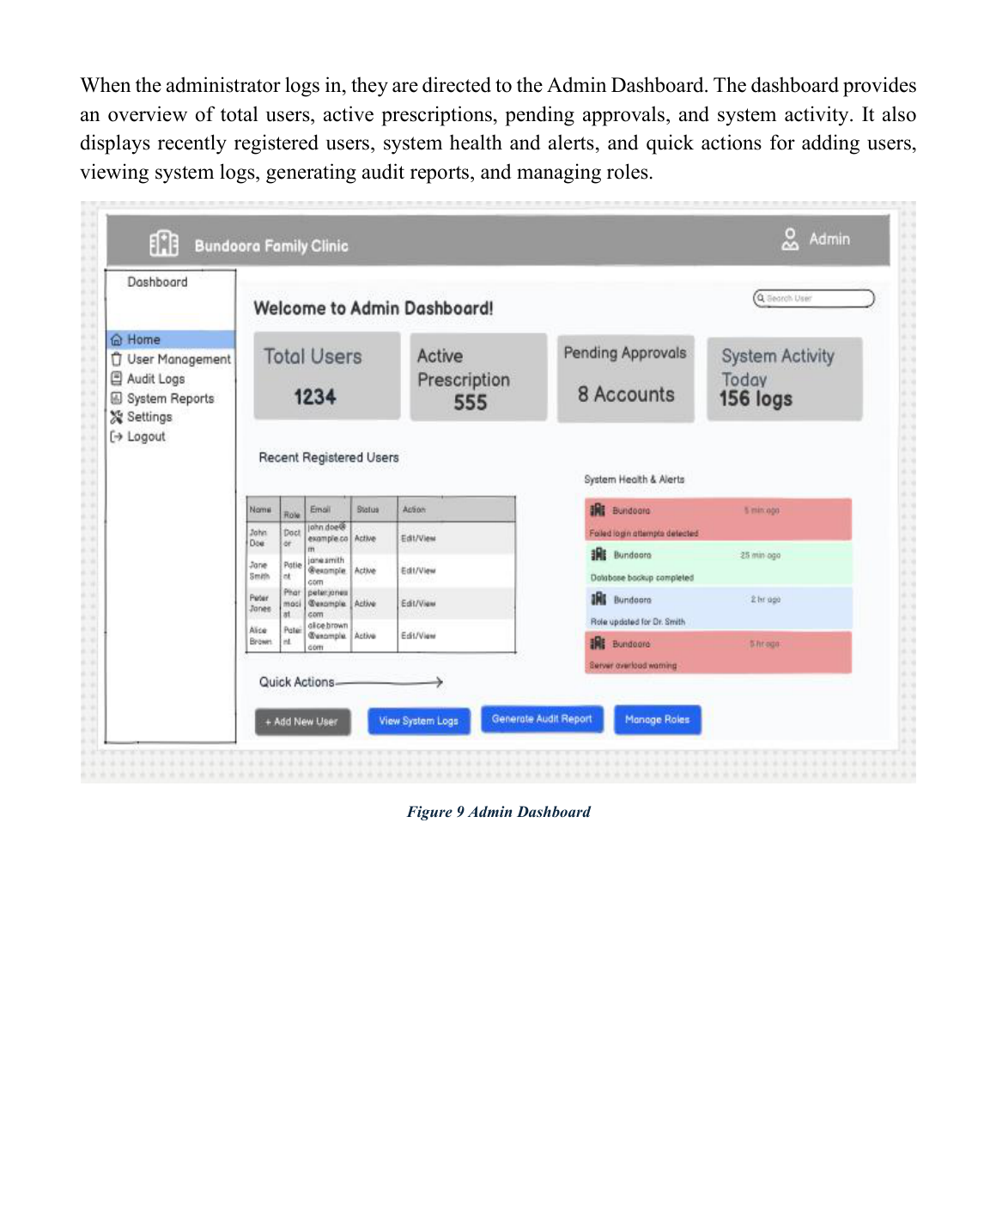
UI Showcase — Prescription Dashboard & Admin Dashboard
UI / ADMIN
Role-based interface screens reproduced from the final SRS report.
Figure/page Prescription Dashboard
Figure/page Admin Dashboard
Presenter: Puja Gurung
18

Slide 15
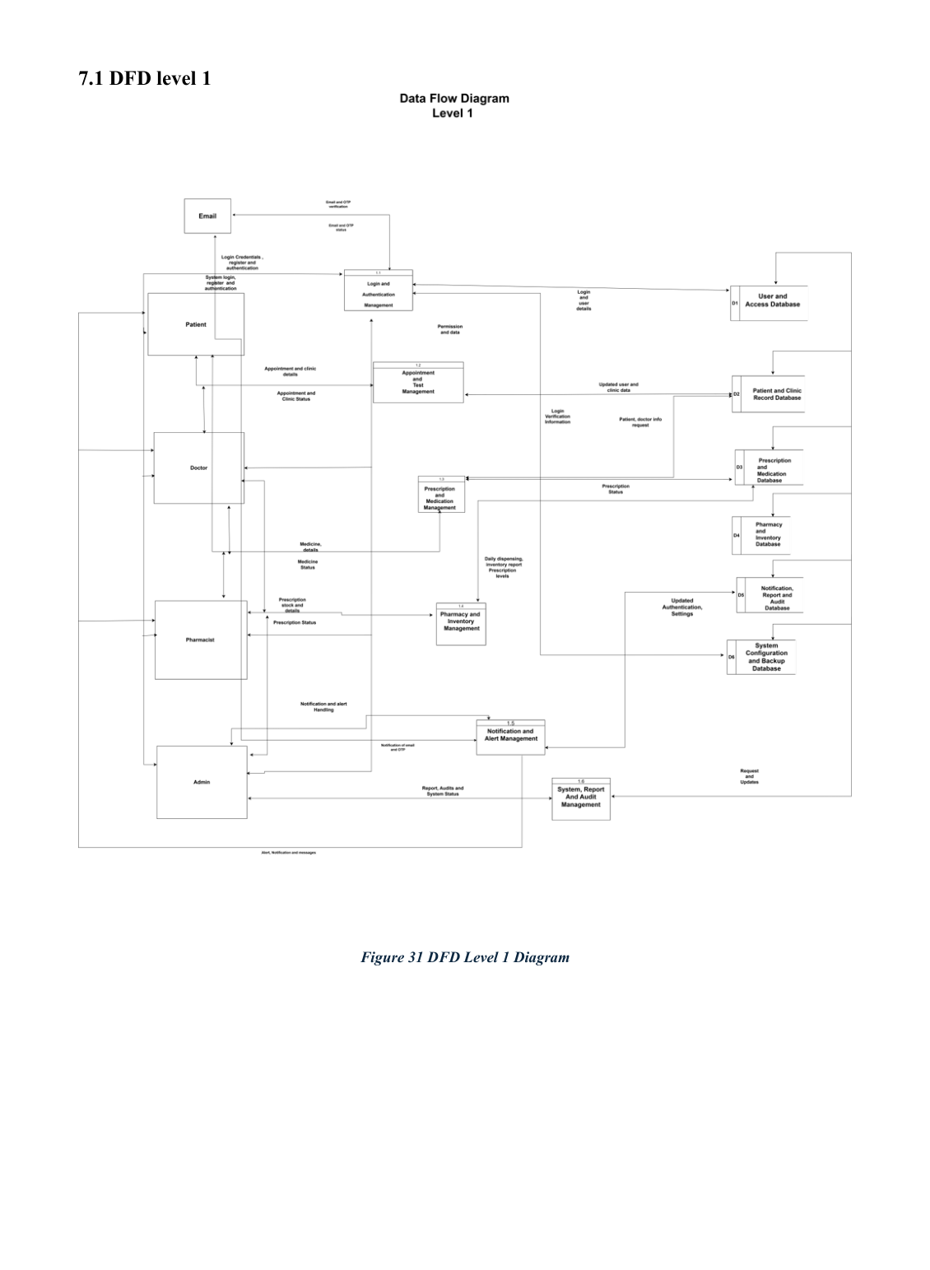
DFD Level 1 — Major Processes
SYSTEM MODELS
Breakdown of authentication, appointments, prescriptions, inventory, notifications and reporting.
Presenter: Puja
31

Slide 16
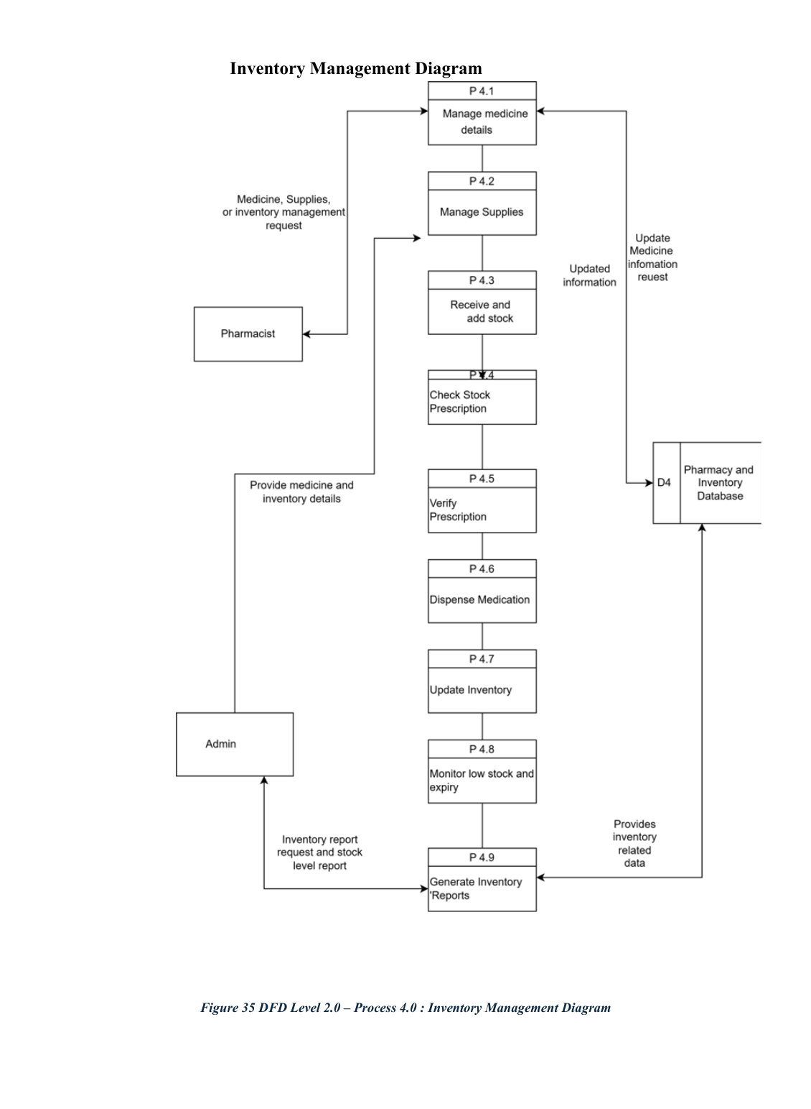
DFD Level 2 — Inventory & Notifications
SYSTEM MODELS
Process 4.0 manages stock; Process 5.0 manages alerts and notifications.
Presenter: Puja Gurung
34

Slide 17
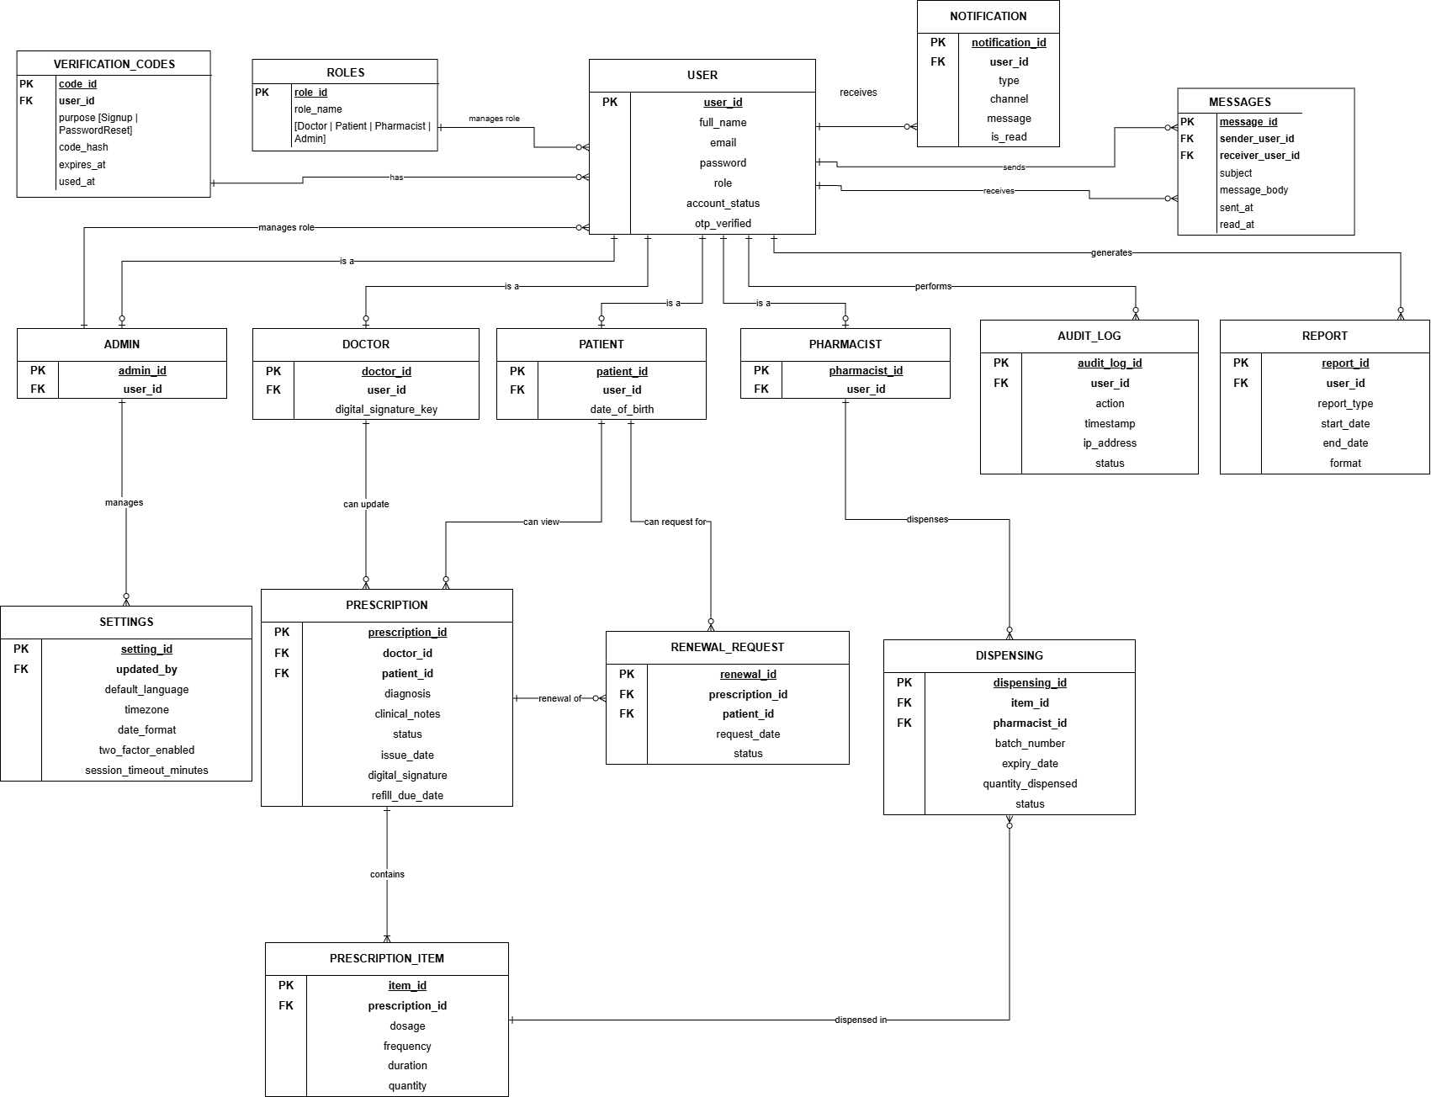
Entity Relationship Diagram (ERD)
DATA DESIGN
Central database relationships for users, prescriptions, medicines, inventory, dispensing, tracking, notifications and audit.
Presenter,Yam Mahotra Puja Gurung
37

Slide 18
Data Protection Impact Assessment — Purpose & Scope
PRIVACY & RISK
DPMTMS processes highly sensitive personal and health information, making privacy risk assessment central to the design.
Why a DPIA is needed
Data sources
The system collects, processes and stores medical histories, prescriptions, medication details and system activity logs.
Doctors, patients, pharmacists and administrators are the sources of system information.
Sensitive categories
Controlled sharing
Health information includes treatment, medication, allergies and doctors' notes.
Sensitive data is shared only with authorized roles; access is restricted through permissions and RBAC.
The report identifies data minimisation, input validation, audit logging, encryption and MFA/strong access controls as privacy safeguards.
Presenter: Utsav Paudel
39

Slide 19
DPIA — Context, Standards & Individual Control
PRIVACY & RISK
Privacy design is aligned with the project's healthcare setting and stated Australian compliance context.
Retention & location
Individual control
The report references Victorian Health Records Act 2001 (Vic) and identifies West Melbourne, Victoria, Australia as the geographical area.
Patients can update personal information, view prescriptions and request renewals; doctors and administrators have role-specific access.
Standards / controls
Public concerns
RBAC, encrypted storage, bcrypt password hashing, audit logging, WCAG accessibility standards and Australian Privacy standards.
Cybersecurity, data privacy and digital-access difficulties for vulnerable users such as elderly people and children.
Presenter: Utsav Paudel
40

Slide 20
DPIA — Key Risks & Mitigation
PRIVACY & RISK
The report identifies high-risk areas and corresponding mitigation measures.
High risks identified
Medium risks identified
Downtime causing prescribing errors; unauthorized access to patient records; cybersecurity data breach.
Limited improvement in health outcomes; implementation/training costs; internet dependency; inaccurate stock; non-compliance.
Mitigation
Residual risk
Backup procedures, reliable internet, regular stock checks, staff training, RBAC, encryption and firewalls.
The report records the proposed controls as reducing risks to Low residual risk with approved measures.
Presenter: Utsav Paudel
41

Slide 21
Conclusion
A centralized DPMTMS can replace fragmented paper-based prescription and medication workflows.
Role-based modules connect doctors, patients, pharmacists and administrators through a consistent system.
The design combines secure architecture, database modelling, detailed process models, privacy controls and testing.
Agile delivery, phased implementation and rollback planning support controlled deployment.
Thank You — Questions & Discussion
Presenter: All group members
46

Slide 22
References & Source
CLOSING
This presentation is derived from the attached Final SRS Report.
Final SRS Report — CPRO306 Capstone Project: Assessment 3.
System title: Bundoora Family Clinic — Digital Prescription and Medication Tracking Management System.
Project repository referenced by the report: github.com/MEL17-Package-ONE/Final-SRS-Report
The presentation reproduces the report's documented UI and system diagrams without adding unsupported external content.
Group
Kunjan Tamang • Darpan Kafle • Puja Gurung • Yam Bahadur Mohatra • Utsav Paudel
Presenter: All group members
48

